Slide 1
Basic Concepts
This lecture slide is mainly based on the power point slides by Professor Lawrie Brown.
Notes:
Zili Shao

Slide 2
Basic Components
Information security means protecting information and information systems from unauthorized access, use, disclosure, disruption, modification, or destruction. The terms information security, computer security and information assurance are frequently used interchangeably. These fields are interrelated and share the common goals of protecting the confidentiality, integrity and availability of information; however, there are some subtle differences between them.
Computer security: To protect the information stored in a computer
Network Security: To protect information during the transmission of information.
CEG 260, Meilin Liu
Notes:
Zili Shao
Confidentiality: a good example is cryptography, which traditionally is used to protect secret messages. But cryptography is traditionally used to protect data, not resources. Resources are protected by limiting information, for example by using firewalls or address translation mechanisms.
Integrity: a good example here is that of an interrupted database transaction, leaving the database in an inconsistent state (this foreshadows the Clark-Wilson model). Trustworthiness of both data and origin affects integrity, as noted in the book’s example. That integrity is tied to trustworthiness makes it much harder to quantify than confidentiality. Cryptography provides mechanisms for detecting violations of integrity, but not preventing them (e.g., a digital signature can be used to determine if data has changed).
Availability: this is usually defined in terms of “quality of service,” in which authorized users are expected to receive a specific level of service (stated in terms of a metric). Denial of service attacks are attempts to block availability.

Slide 3
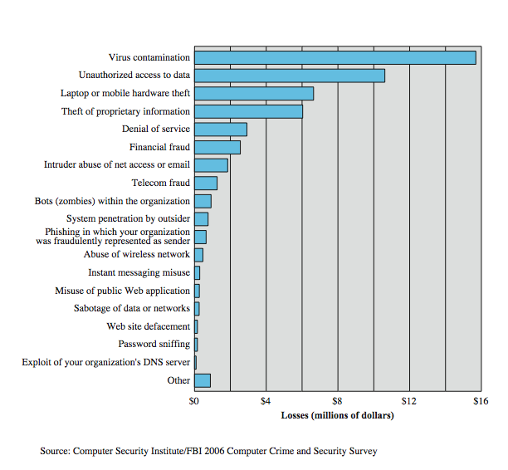
Computer Security Losses
CEG 260, Meilin Liu
Notes:
Zili Shao
Another useful view of trends in computer security is provided by the CSI/FBI Computer Crime and Security Survey for 2006, conducted by the Computer Security Institute, a private organization, and the U.S. Federal Bureau of Investigation (FBI). Figure 1.7 here shows the estimated losses caused by various types of computer security incidents. The top four categories of losses (viruses, unauthorized access, laptop or mobile hardware theft, and theft of proprietary information) accounted for nearly three-quarters of the total loss. Note that these attacks need to be countered by technical measures (in the case of viruses and unauthorized access); physical security measures (laptop or mobile hardware theft); or a combination (theft of proprietary information, which could include electronic as well as paper assets). Other management controls would also come into play.

Slide 4
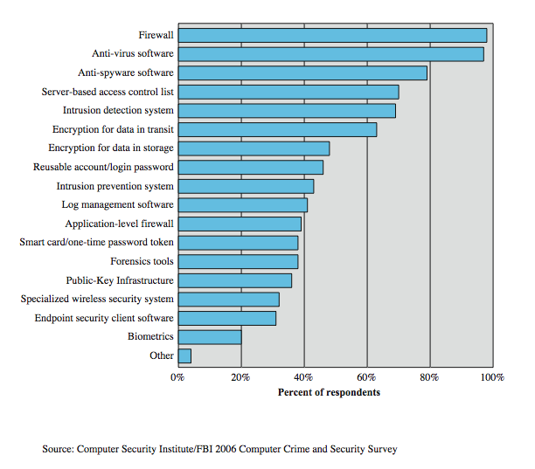
Security Technologies Used
CEG 260, Meilin Liu
Notes:
Zili Shao
Figure 1.8here, also from the CSI/FBI Computer Crime and Security Survey for 2006, indicates the types of security technology used by organizations to counter threats. Both firewalls and anti-virus software are used almost universally. This popularity reflects a number of factors:
• The maturity of these technologies means that security administrators are very familiar with the products and are confident of their effectiveness.
• Because these technologies are mature and there are a number of vendors, costs tend to be quite reasonable and user-friendly interfaces are available
• The threats countered by these technologies are among the most significant facing security administrators.

Slide 5

Security Objectives – the CIA Triad
Security Features
Security Requirements
Security Services
CEG 260, Meilin Liu
Notes:
Zili Shao
Another useful view of trends in computer security is provided by the CSI/FBI Computer Crime and Security Survey for 2006, conducted by the Computer Security Institute, a private organization, and the U.S. Federal Bureau of Investigation (FBI). Figure 1.7 here shows the estimated losses caused by various types of computer security incidents. The top four categories of losses (viruses, unauthorized access, laptop or mobile hardware theft, and theft of proprietary information) accounted for nearly three-quarters of the total loss. Note that these attacks need to be countered by technical measures (in the case of viruses and unauthorized access); physical security measures (laptop or mobile hardware theft); or a combination (theft of proprietary information, which could include electronic as well as paper assets). Other management controls would also come into play.

Slide 6
Security Requirements
Confidentiality: Ensures that the information in a computer system and transmitted information are accessible only for reading by authorized parties.
Integrity : Ensures that only authorized parties are able to modify computer system assets and transmitted information.
Availability: Requires that computer system assets be available to authorized parties when needed.
CEG 260, Meilin Liu
Notes:
Zili Shao
Confidentiality: a good example is cryptography, which traditionally is used to protect secret messages. But cryptography is traditionally used to protect data, not resources. Resources are protected by limiting information, for example by using firewalls or address translation mechanisms.
Integrity: a good example here is that of an interrupted database transaction, leaving the database in an inconsistent state (this foreshadows the Clark-Wilson model). Trustworthiness of both data and origin affects integrity, as noted in the book’s example. That integrity is tied to trustworthiness makes it much harder to quantify than confidentiality. Cryptography provides mechanisms for detecting violations of integrity, but not preventing them (e.g., a digital signature can be used to determine if data has changed).
Availability: this is usually defined in terms of “quality of service,” in which authorized users are expected to receive a specific level of service (stated in terms of a metric). Denial of service attacks are attempts to block availability.

Slide 7
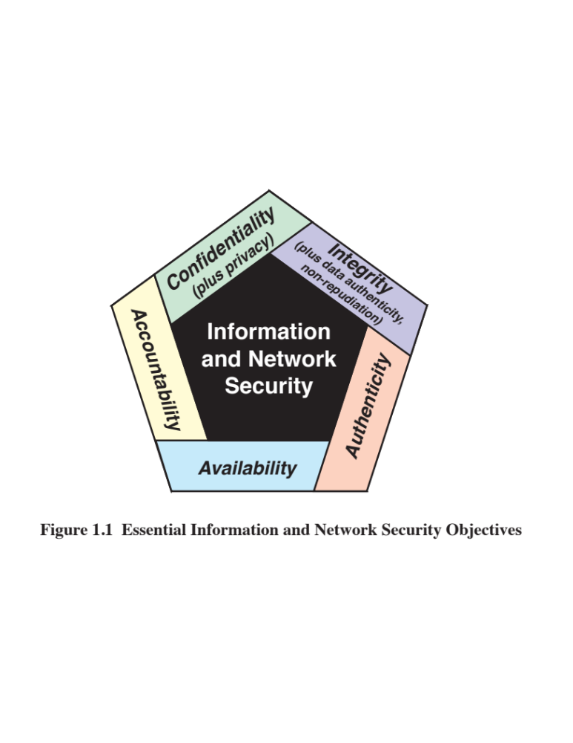
© 2020 Pearson Education, Inc., Hoboken, NJ. All rights reserved
Notes:
These three concepts form what is often referred to as the CIA triad. The three
concepts embody the fundamental security objectives for both data and for information
and computing services. For example, the NIST standard FIPS 199 (Standards
for Security Categorization of Federal Information and Information Systems ) lists
confidentiality, integrity, and availability as the three security objectives for information
and for information systems. FIPS 199 provides a useful characterization of
these three objectives in terms of requirements and the definition of a loss of security
in each category:
• Confidentiality: Preserving authorized restrictions on information access
and disclosure, including means for protecting personal privacy and proprietary
information. A loss of confidentiality is the unauthorized disclosure of
information.
• Integrity: Guarding against improper information modification or destruction,
including ensuring information nonrepudiation and authenticity. A loss
of integrity is the unauthorized modification or destruction of information.
• Availability: Ensuring timely and reliable access to and use of information.
A loss of availability is the disruption of access to or use of information or an
information system.
Although the use of the CIA triad to define security objectives is well established, some
in the security field feel that additional concepts are needed to present a complete picture (Figure 1.1).
Two of the most commonly mentioned are as follows:
• Authenticity: The property of being genuine and being able to be verified and
trusted; confidence in the validity of a transmission, a message, or message
originator. This means verifying that users are who they say they are and that
each input arriving at the system came from a trusted source.
• Accountability: The security goal that generates the requirement for actions
of an entity to be traced uniquely to that entity. This supports nonrepudiation,
deterrence, fault isolation, intrusion detection and prevention, and after action
recovery and legal action. Because truly secure systems are not yet an
achievable goal, we must be able to trace a security breach to a responsible
party. Systems must keep records of their activities to permit later forensic
analysis to trace security breaches or to aid in transaction disputes.

Slide 8
Security Requirements
Authenticity: Ensures that the origin of a message or electronic document is correctly identified.
Non-repudiation : Requires that neither the sender nor the receiver of message be able to deny the transmission.
Accountability: Ensures that actions of an entity to be traced uniquely to that entity
CEG 260, Meilin Liu
Notes:
Zili Shao
Confidentiality: a good example is cryptography, which traditionally is used to protect secret messages. But cryptography is traditionally used to protect data, not resources. Resources are protected by limiting information, for example by using firewalls or address translation mechanisms.
Integrity: a good example here is that of an interrupted database transaction, leaving the database in an inconsistent state (this foreshadows the Clark-Wilson model). Trustworthiness of both data and origin affects integrity, as noted in the book’s example. That integrity is tied to trustworthiness makes it much harder to quantify than confidentiality. Cryptography provides mechanisms for detecting violations of integrity, but not preventing them (e.g., a digital signature can be used to determine if data has changed).
Availability: this is usually defined in terms of “quality of service,” in which authorized users are expected to receive a specific level of service (stated in terms of a metric). Denial of service attacks are attempts to block availability.

Slide 9
Policies, Mechanisms, Attacks
Policy says what is, and is not, allowed
  This defines “security” for the site/system/etc.
  A Security Policy is a statement of what is, and what is not allowed
A Security mechanism is a method, tool, or procedure for enforcing a security policy.
Composition of policies
  If policies conflict, discrepancies may create security vulnerabilities
Security attack: An action that compromises the security of information.
CEG 260, Meilin Liu
Notes:
Zili Shao
Policy: may be expressed in
natural language, which is usually imprecise but easy to understand;
mathematics, which is usually precise but hard to understand;
policy languages, which look like some form of programming language and try to balance precision with ease of understanding
Mechanisms: may be
technical, in which controls in the computer enforce the policy; for example, the requirement that a user supply a password to authenticate herself before using the computer
procedural, in which controls outside the system enforce the policy; for example, firing someone for ringing in a disk containing a game program obtained from an untrusted source
The composition problem requires checking for inconsistencies among policies. If, for example, one policy allows students and faculty access to all data, and the other allows only faculty access to all the data, then they must be resolved (e.g., partition the data so that students and faculty can access some data, and only faculty access the other data).

Slide 10
Goals of Security
Prevention
  Prevent attackers from violating security policy
Detection
  Detect attackers’ violation of security policy
Recovery
  Stop attack, assess and repair damage
  Continue to function correctly even if attack succeeds
CEG 260, Meilin Liu
Notes:
Zili Shao
Prevention is ideal, because then there are no successful attacks.
Detection occurs after someone violates the policy. The mechanism determines that a violation of the policy has occurred (or is underway), and reports it. The system (or system security officer) must then respond appropriately.
Recovery means that the system continues to function correctly, possibly after a period during which it fails to function correctly. If the system functions correctly always, but possibly with degraded services, it is said to be intrusion tolerant. This is very difficult to do correctly; usually, recovery means that the attack is stopped, the system fixed (which may involve shutting down the system for some time, or making it unavailable to all users except the system security officers), and then the system resumes correct operations.

Slide 11
Categorization of Attacks
Wiretapping: An unauthorized party gains access to an asset.
Modification : An unauthorized party not only gains access to but tampers with an asset.
Denial of Service : An asset of system is destroyed or becomes unavailable or unusable.
Forgery: An unauthorized party inserts counterfeit objects into the system.
A sender or recipient can falsely deny knowledge of a message
CEG 260, Meilin Liu
Notes:
Zili Shao
Confidentiality: a good example is cryptography, which traditionally is used to protect secret messages. But cryptography is traditionally used to protect data, not resources. Resources are protected by limiting information, for example by using firewalls or address translation mechanisms.
Integrity: a good example here is that of an interrupted database transaction, leaving the database in an inconsistent state (this foreshadows the Clark-Wilson model). Trustworthiness of both data and origin affects integrity, as noted in the book’s example. That integrity is tied to trustworthiness makes it much harder to quantify than confidentiality. Cryptography provides mechanisms for detecting violations of integrity, but not preventing them (e.g., a digital signature can be used to determine if data has changed).
Availability: this is usually defined in terms of “quality of service,” in which authorized users are expected to receive a specific level of service (stated in terms of a metric). Denial of service attacks are attempts to block availability.

Slide 12
Active/Passive Attacks
Passive Attacks :
  The goal of the intruder is to obtain information being transmitted.
  Ex. Release of message contents, traffic analysis.
  Passive attacks are very difficult to detect because they do not involve any alteration of the data.
CEG 260, Meilin Liu
Notes:
Zili Shao
Policy: may be expressed in
natural language, which is usually imprecise but easy to understand;
mathematics, which is usually precise but hard to understand;
policy languages, which look like some form of programming language and try to balance precision with ease of understanding
Mechanisms: may be
technical, in which controls in the computer enforce the policy; for example, the requirement that a user supply a password to authenticate herself before using the computer
procedural, in which controls outside the system enforce the policy; for example, firing someone for ringing in a disk containing a game program obtained from an untrusted source
The composition problem requires checking for inconsistencies among policies. If, for example, one policy allows students and faculty access to all data, and the other allows only faculty access to all the data, then they must be resolved (e.g., partition the data so that students and faculty can access some data, and only faculty access the other data).

Slide 13
Active/Passive Attacks
Active Attacks :
  Active attacks involve some modification of the data stream or the creation of a false stream.
  Ex. Masquerade, replay, modification of the messages, denial of service (DoS).
  Active attacks are easier to detect than passive attacks. The goal of security is to detect them and to recover from any disruption or delay caused by them
CEG 260, Meilin Liu
Notes:
Zili Shao
Policy: may be expressed in
natural language, which is usually imprecise but easy to understand;
mathematics, which is usually precise but hard to understand;
policy languages, which look like some form of programming language and try to balance precision with ease of understanding
Mechanisms: may be
technical, in which controls in the computer enforce the policy; for example, the requirement that a user supply a password to authenticate herself before using the computer
procedural, in which controls outside the system enforce the policy; for example, firing someone for ringing in a disk containing a game program obtained from an untrusted source
The composition problem requires checking for inconsistencies among policies. If, for example, one policy allows students and faculty access to all data, and the other allows only faculty access to all the data, then they must be resolved (e.g., partition the data so that students and faculty can access some data, and only faculty access the other data).

Slide 14
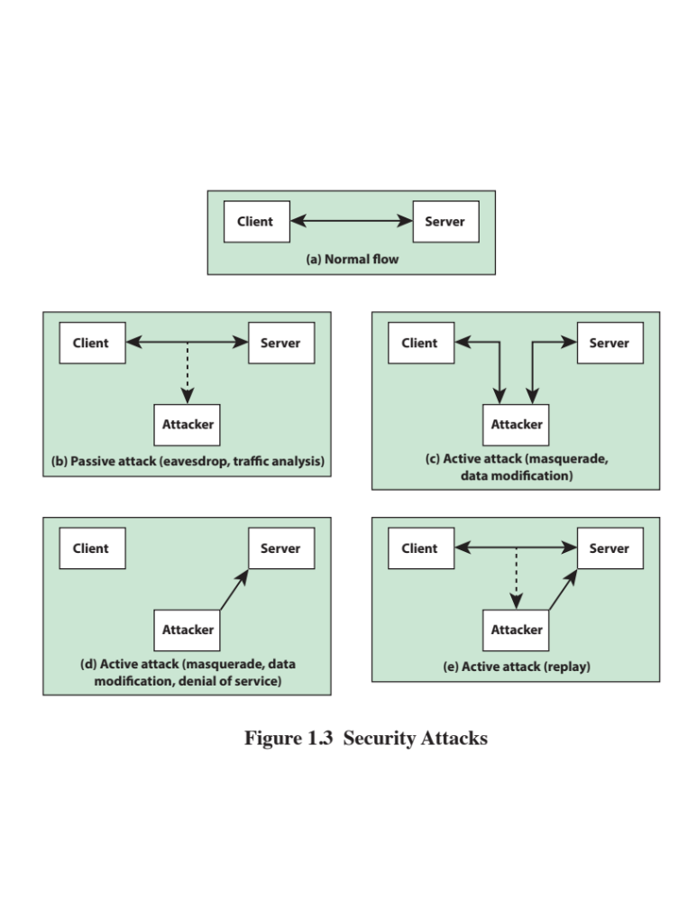
© 2020 Pearson Education, Inc., Hoboken, NJ. All rights reserved
Notes:
Figure 1.3 illustrates the types of attacks in the context of a client/server interaction. A passive attack (Figure 1.3b)
does not disturb the information flow between the client and server, but is able to observe that flow.
A masquerade can take the form of a man-in-the-middle attack (Figure 1.3c). In this type of attack, the attacker intercepts masquerades as the client to the server and as the server to the client. We see specific applications of this attack in defeating key exchange and distribution protocols (Chapters 10 and 14) and in message authentication protocols (Chapter 11). More generally, it can be used to impersonate the two ends of a legitimate communication. Another form of masquerade is illustrated in Figure 1.3d. Here, an attacker is able to access server resources by masquerading as an authorized user.
Data modification may involve a man-in-the middle attack, in which the attacker selectively modifies communicated data between a client and server (Figure 1.3c). Another form of data modification attack is the modification of data residing on a serve or other system after an attacker gains unauthorized access (Figure 1.3d).
Figure 1.3e illustrates the replay attack. As in a passive attack, the attacker does not disturb the information flow between client and server, but does capture client message. The attacker can then subsequently replay any client message to the server.
Figure 1.3d also illustrates denial of service in the context of a client/server environment. The denial of service can take two forms: (1) flooding the server with an overwhelming amount of data; and (2) triggering some action on the server that consumes substantial computing resources.

Slide 15
Flaws in Methods of Communication
Methods of communication can be insecure in several ways:
  If a message is intercepted, it can be read by an undesirable third party (lack of confidentiality)
  An intermediary may tamper with a message before it reaches the recipient (inability to verify integrity)
  An impostor may have written a message to deceive the recipient (inability to verify authenticity)
  A sender or recipient can falsely deny knowledge of a message (lack of non-repudiation and proof of delivery)
CEG 260, Meilin Liu
Notes:
Zili Shao
Confidentiality: a good example is cryptography, which traditionally is used to protect secret messages. But cryptography is traditionally used to protect data, not resources. Resources are protected by limiting information, for example by using firewalls or address translation mechanisms.
Integrity: a good example here is that of an interrupted database transaction, leaving the database in an inconsistent state (this foreshadows the Clark-Wilson model). Trustworthiness of both data and origin affects integrity, as noted in the book’s example. That integrity is tied to trustworthiness makes it much harder to quantify than confidentiality. Cryptography provides mechanisms for detecting violations of integrity, but not preventing them (e.g., a digital signature can be used to determine if data has changed).
Availability: this is usually defined in terms of “quality of service,” in which authorized users are expected to receive a specific level of service (stated in terms of a metric). Denial of service attacks are attempts to block availability.

Slide 16




Cryptography
Solution: Cryptography is the art and science of secret writing
  Crypto: hidden, secret
  Graph: writing
“…… is about communication in the presence of adversaries” (R. Rivest)
message
Insecure channel
Alice
Bob
Adversaries

Slide 17
Cryptosystem
A cryptosystem is a 5-tuple consisting of
(E, D, M, K, C)
Where,
E is the set of encryption algorithms
D is the set of decryption algorithms
M is the set of plaintexts
K is the set of keys
C is the set of ciphertexts
E: M × K -> C
D: C × K -> M

Slide 18


Cryptosystem
plaintext
Encrypt (Enc)
ciphertext
ciphertext
Decrypt (Dec)
plaintext
Alice
Bob
key
key
Symmetric-key cryptosystem: cryptosystem that uses the same key for encryption and decryption
Asymmetric-key cryptosystem: cryptosystem that uses a public-key/private-key pair for encryption and decryption

Slide 19

Symmetric-Key Cryptosystem
plaintext
Encrypt (E)
ciphertext
ciphertext
Decrypt (D)
plaintext
Alice
Bob
key
key
Enc(key, plaintext) = ciphertext
Dec(key, ciphertext) = plaintext

Slide 20

Cryptographic System
CEG 260, Meilin Liu
Notes:
Zili Shao

Slide 21
Symmetric Key Cryptography
Simplest type of encryption uses just one key, a “shared secret” possessed by all authorized parties: symmetric key crypto
This is computationally simple and fast
Small key sizes (128-256 bits nowadays) make brute-force attacks hard enough to provide sufficient security
Major downside: shared secret must be securely communicated to all parties
This is difficult without other means of communication between the parties
CEG 260, Meilin Liu
Notes:
Zili Shao
Policy: may be expressed in
natural language, which is usually imprecise but easy to understand;
mathematics, which is usually precise but hard to understand;
policy languages, which look like some form of programming language and try to balance precision with ease of understanding
Mechanisms: may be
technical, in which controls in the computer enforce the policy; for example, the requirement that a user supply a password to authenticate herself before using the computer
procedural, in which controls outside the system enforce the policy; for example, firing someone for ringing in a disk containing a game program obtained from an untrusted source
The composition problem requires checking for inconsistencies among policies. If, for example, one policy allows students and faculty access to all data, and the other allows only faculty access to all the data, then they must be resolved (e.g., partition the data so that students and faculty can access some data, and only faculty access the other data).

Slide 22
Symmetric Key Techniques
Encryption and decryption algorithms are the same but in reverse; they're symmetric
If encryption key and decryption key differ, one is a trivial transformation of the other
Algorithms can process one bit at a time (“stream cipher”) or a fixed-size block of bits at once (“block cipher”)
  Common block ciphers: DES, 3DES, AES
  Common stream cipher: RC4
Most common symmetric key ciphers are block ciphers
CEG 260, Meilin Liu
Notes:
Zili Shao
Prevention is ideal, because then there are no successful attacks.
Detection occurs after someone violates the policy. The mechanism determines that a violation of the policy has occurred (or is underway), and reports it. The system (or system security officer) must then respond appropriately.
Recovery means that the system continues to function correctly, possibly after a period during which it fails to function correctly. If the system functions correctly always, but possibly with degraded services, it is said to be intrusion tolerant. This is very difficult to do correctly; usually, recovery means that the attack is stopped, the system fixed (which may involve shutting down the system for some time, or making it unavailable to all users except the system security officers), and then the system resumes correct operations.

Slide 23
Asymmetric-Key Cryptosystem
Public Key Cryptosystem
plaintext
Encrypt (E)
ciphertext
ciphertext
Decrypt (D)
plaintext
Alice
Bob
S_{Alice}, K_{Alice}
K_{Bob}
S_{Bob}
S_{Bob}, K_{Bob}
Enc(K_{Bob}, plaintext) = ciphertext
Dec(S_{Bob}, ciphertext) = plaintext

Slide 24
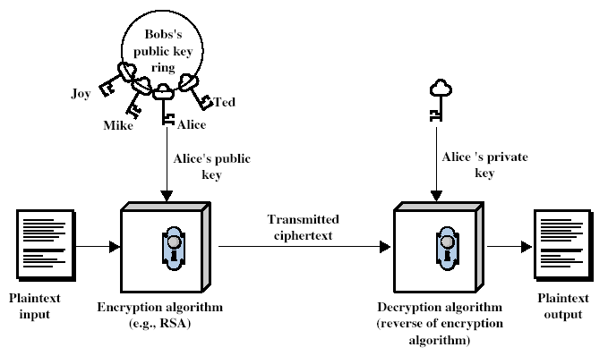
Public-Key Cryptography
CEG 260, Meilin Liu
Notes:
Zili Shao
Stallings Fig 9.1

Slide 25
Public Key Cryptography
A Symmetric key cryptography requires a shared secret to be communicated separately and securely. This is a pain!
Alternative: asymmetric key cryptography, a.k.a., public key cryptography
Based on hard computational problems that are easy in one direction and hard in the other
Generate a public key, which can be shared freely, and a private key, which is secret
Sender encrypts using recipient's public key; recipient's secret private key needed to decrypt
Two problems often used are factoring very large numbers and the discrete logarithm problem
CEG 260, Meilin Liu
Notes:
Zili Shao
A reachable state is one that the computer can enter. A secure state is a state defined as allowed by the security policy.
The left figure shows a secure system: all reachable states are in the set of secure states. The system can never enter (reach) a non-secure state, but there are secure states that the system cannot reach.
The middle figure shows a precise system: all reachable states are secure, and all secure states are reachable. Only the non-secure states are unreachable.
The right figure shows a broad system. Some non-secure states are reachable. This system is also not secure.

Slide 26
Public Key vs. Symmetric Key
Symmetric Key Cryptography requires a secure channel
Public Key Cryptography is expensive
We can use public keys to securely create a symmetric key
Diffie-Helman Key Exchange
CEG 260, Meilin Liu
Notes:
Zili Shao
A reachable state is one that the computer can enter. A secure state is a state defined as allowed by the security policy.
The left figure shows a secure system: all reachable states are in the set of secure states. The system can never enter (reach) a non-secure state, but there are secure states that the system cannot reach.
The middle figure shows a precise system: all reachable states are secure, and all secure states are reachable. Only the non-secure states are unreachable.
The right figure shows a broad system. Some non-secure states are reachable. This system is also not secure.

Slide 27
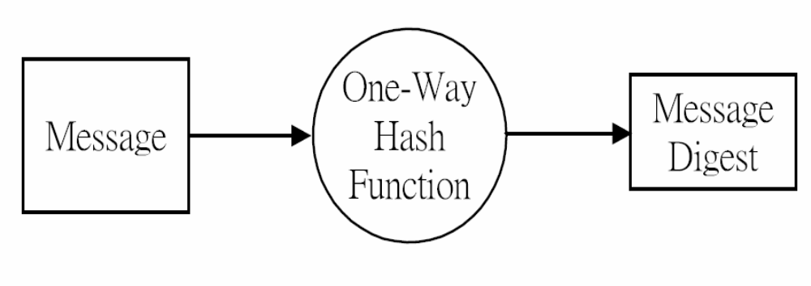
Cryptographic Hash Functions
CEG 260, Meilin Liu
Notes:
Zili Shao
All security policies and mechanisms rest on assumptions; we’ll examine some in later chapters, most notably Chapter 22, Malicious Logic. Here is a taste of the assumptions.
Policies: as these define security, they have to define security correctly for the particular site. For example, a web site has to be available, but if the security policy does not mention availability, the definition of security is inappropriate for the site. Also, a policy may not specify whether a particular state is “secure” or “non-secure.” This ambiguity causes problems.
Mechanisms: as these enforce policy, they must be appropriate. For example, cryptography does not assure availability, so using cryptography in the above situation won’t work. Further, security mechanisms rely on supporting infrastructure, such as compilers, libraries, the hardware, and networks to work correctly. Ken Thompson’s modified C preprocessor (see the example on p. 615) illustrates this point very well.

Slide 28
Cryptographic Hash Functions
For secure use in cryptography, a hash function has additional requirements:
  The digest must not reveal anything about the plaintext message
  It must be computationally hard to:
    discover an unknown message matching a given hash (“preimage resistant”)
find a message different from a given message with
the same hash as that given message (“second preimage resistant”)
find two messages that have the same or substantially
similar hash (“collision-resistant”)
Common Cryptographic Hash Functions: SHA-512 and SHA-3
CEG 260, Meilin Liu
Notes:
Zili Shao
A reachable state is one that the computer can enter. A secure state is a state defined as allowed by the security policy.
The left figure shows a secure system: all reachable states are in the set of secure states. The system can never enter (reach) a non-secure state, but there are secure states that the system cannot reach.
The middle figure shows a precise system: all reachable states are secure, and all secure states are reachable. Only the non-secure states are unreachable.
The right figure shows a broad system. Some non-secure states are reachable. This system is also not secure.

Slide 29
Digital Signatures
Alice wants to send a message and prove that it comes from her
  Option: Use symmetric key encryption
    Requires previous secure communication
    Only works with single recipient
Can we use public key encryption?
  In many algorithms, using the private key to encrypt a message will create a ciphertext which can be decrypted using the public key
Alice can use a private key to “sign” a message anyone can still read
CEG 260, Meilin Liu
Notes:
Zili Shao
Confidentiality: a good example is cryptography, which traditionally is used to protect secret messages. But cryptography is traditionally used to protect data, not resources. Resources are protected by limiting information, for example by using firewalls or address translation mechanisms.
Integrity: a good example here is that of an interrupted database transaction, leaving the database in an inconsistent state (this foreshadows the Clark-Wilson model). Trustworthiness of both data and origin affects integrity, as noted in the book’s example. That integrity is tied to trustworthiness makes it much harder to quantify than confidentiality. Cryptography provides mechanisms for detecting violations of integrity, but not preventing them (e.g., a digital signature can be used to determine if data has changed).
Availability: this is usually defined in terms of “quality of service,” in which authorized users are expected to receive a specific level of service (stated in terms of a metric). Denial of service attacks are attempts to block availability.

Slide 30
More on Digital Signatues
Rather than encrypting the whole message, Alice first hashes the message and signs the hash
Digital signatures use hash algorithm and encryption algorithm
In addition to authenticity, digital signatures provide integrity and non-repudiation
  The hashes will not match without integrity, even if the owner did send the message.
  Since the key owner's authorship is provable by anyone, subsequent denial is not plausible
CEG 260, Meilin Liu
Notes:
Zili Shao
Confidentiality: a good example is cryptography, which traditionally is used to protect secret messages. But cryptography is traditionally used to protect data, not resources. Resources are protected by limiting information, for example by using firewalls or address translation mechanisms.
Integrity: a good example here is that of an interrupted database transaction, leaving the database in an inconsistent state (this foreshadows the Clark-Wilson model). Trustworthiness of both data and origin affects integrity, as noted in the book’s example. That integrity is tied to trustworthiness makes it much harder to quantify than confidentiality. Cryptography provides mechanisms for detecting violations of integrity, but not preventing them (e.g., a digital signature can be used to determine if data has changed).
Availability: this is usually defined in terms of “quality of service,” in which authorized users are expected to receive a specific level of service (stated in terms of a metric). Denial of service attacks are attempts to block availability.

Slide 31
Sign and Encrypt?
Alice wants to send a message that only Bob can read and that only she can have sent.
Can sign the plaintext, and then encrypt
But Bob doesn’t know Alice intended the message for him
CEG 260, Meilin Liu
Notes:
Zili Shao
Confidentiality: a good example is cryptography, which traditionally is used to protect secret messages. But cryptography is traditionally used to protect data, not resources. Resources are protected by limiting information, for example by using firewalls or address translation mechanisms.
Integrity: a good example here is that of an interrupted database transaction, leaving the database in an inconsistent state (this foreshadows the Clark-Wilson model). Trustworthiness of both data and origin affects integrity, as noted in the book’s example. That integrity is tied to trustworthiness makes it much harder to quantify than confidentiality. Cryptography provides mechanisms for detecting violations of integrity, but not preventing them (e.g., a digital signature can be used to determine if data has changed).
Availability: this is usually defined in terms of “quality of service,” in which authorized users are expected to receive a specific level of service (stated in terms of a metric). Denial of service attacks are attempts to block availability.

Slide 32
Encrypt and Sign?
What if Alice encrypts first, then signs?
Alice could still repudiate the plaintext
Or a “man in the middle” could replace Alice’s signature with his own, and claim that the message comes from him
What to do?
  Alice can sign Bob’s public key along with the message
  Alice can sign both plaintext and ciphertext
CEG 260, Meilin Liu
Notes:
Zili Shao
Confidentiality: a good example is cryptography, which traditionally is used to protect secret messages. But cryptography is traditionally used to protect data, not resources. Resources are protected by limiting information, for example by using firewalls or address translation mechanisms.
Integrity: a good example here is that of an interrupted database transaction, leaving the database in an inconsistent state (this foreshadows the Clark-Wilson model). Trustworthiness of both data and origin affects integrity, as noted in the book’s example. That integrity is tied to trustworthiness makes it much harder to quantify than confidentiality. Cryptography provides mechanisms for detecting violations of integrity, but not preventing them (e.g., a digital signature can be used to determine if data has changed).
Availability: this is usually defined in terms of “quality of service,” in which authorized users are expected to receive a specific level of service (stated in terms of a metric). Denial of service attacks are attempts to block availability.

Slide 33
Certificates
Problem: how do we verify identity on the Internet?
Use digital signatures?
But we would need to have everybody’s public key already
Solution: Certificates
Third party (certificate authority) signs a message saying essentially, “XYZ, Inc. has the following public key.”
Users (web browsers, etc.) have a list of certificate authorities and their public keys
CEG 260, Meilin Liu
Notes:
Zili Shao
Confidentiality: a good example is cryptography, which traditionally is used to protect secret messages. But cryptography is traditionally used to protect data, not resources. Resources are protected by limiting information, for example by using firewalls or address translation mechanisms.
Integrity: a good example here is that of an interrupted database transaction, leaving the database in an inconsistent state (this foreshadows the Clark-Wilson model). Trustworthiness of both data and origin affects integrity, as noted in the book’s example. That integrity is tied to trustworthiness makes it much harder to quantify than confidentiality. Cryptography provides mechanisms for detecting violations of integrity, but not preventing them (e.g., a digital signature can be used to determine if data has changed).
Availability: this is usually defined in terms of “quality of service,” in which authorized users are expected to receive a specific level of service (stated in terms of a metric). Denial of service attacks are attempts to block availability.

